Slide 1
Paediatrics – History Taking
By Thomas Tay
Adapted from Lissauer and Carroll

Slide 2
Key features
The child’s age will determine
The way history taking and examination is conducted
Management plan
Nature of the problem
Acutely ill – focused and concise
Developmental assessment – detailed evaluation
Observation
Appearance
Behavior/ Play
Gait

Slide 3
Nomenclature based on age
Neonate (< 4 weeks)
Infant (< 1 year)
Toddler (1 – 2 years)
Preschool/ Young child (2– 5 years)
School age/ Older child
Teenager/ Adolescent

Slide 4
History taking
Introduction
Presenting complaint
General enquiry
Systems review
Past medical history
Medication
Family history
Social history
Development

Slide 5
History taking - Introduction
Read referral letter
Know the child by name and gender
Introduce self
Determine relationship of adult to child

Slide 6
History taking – Presenting complaint
Why are they here?
Onset and progression
Previous episodes
Exacerbating and relieving factors
Associated symptoms
What was done?
How is he/she now?

Slide 7
History taking – General enquiry
General health
How active?
When was the last time he was his normal self?
Normal growth
Is the child following their height and weight centiles?
Appetite
Recent changes in behavior

Slide 8
History taking – Systems review
General – rashes, fever
Neuro – development, vision, hearing, seizures, headaches
Ear, nose throat – earache, throat infections, snoring, stridor
Respiratory – cough, wheeze, breathing problems
Cardiovascular – cyanosis, exercise tolerance, faints
GI – vomiting, diarrhoea/ constipation, abdominal pain
GU – frequency, dysuria, wetting
Pubertal development
Musculoskeletal – gait, limb pain/ swelling

Slide 9
History taking – Past medical history
Maternal obstetric problems
Antenatal scans
Screening bloods
Complications during delivery
Birthweight and gestation
Perinatal problems
NICU admission
Immunizations
Past hospital admissions

Slide 10
History taking – MFS
Medication history
Present, past medications, allergies
Family history
Family with similar conditions
Social history
Who he lives with, who takes care of him?
Anyone in the family smokes, drinks, do drugs?
Finance
Child’s preferred play/ leisure activities
How has the illness affected him?

Slide 11
History taking - Development
Parental concerns (Mother knows best!)
Development (milestones/ progress at school)
Vision
Hearing
Bladder and bowel control (young child)
Temperament
Behaviour
Sleeping problems

Slide 12
Summary
History taking
Introduction
Presenting complaint and its history
General enquiry
Systems review
Past medical history
MFS history
Medication
Family
Social history
Development

Slide 13
Pediatrics – Physical Examination
By Thomas Tay
Adapted from Lissauer and Carroll

Slide 14
Physical Examination - Principles
Adapt to the child’s age
Babies – on the couch with parent nearby
Toddler – on mother’s lap/ over mother’s shoulder
Preschool – while they are playing
Obtain the child’s cooperation
Make eye contact an smile
Eye level at or below the child’s
Engage in play or conversation
Tell them what you are going to do
Mock examinations (on teddy/ mother’s arm) might be useful
Start away from face, leave unpleasant areas (ear/throat) to the last

Slide 15
Physical Examination (Observe)
Observe before you examine
Assess:
Severity of illness
Growth and nutrition
Behaviour and social responsiveness
Hygiene

Slide 16
Physical Examination – Acute presentation
Perform ABCD (Airway, Breathing, Circulation, Disability)
Airway
Presence of stridor, wheeze, cyanosis
Breathing
Respiratory rate and effort
Circulation
Pulse rate, volume, peripheral temperature, capillary refil time
Disability
Level of consciousness

Slide 17
Physical Examination - Measurements
Growth centile chart plotting
Weight
Length/ height
Head circumference
In infants
In older children if there is neurological problem
Vital signs
Temperature
Blood pressure

Slide 18
Physical Examination
General appearance
System based examination
Respiratory system
Cardiovascular system
Abdominal system
Kidneys
Abnormal masses
Genital area
Rectal examination
Neurological screen
Detailed neurological examination
Bones and joints
Neck
Eyes
Nose and Throat

Slide 19
Respiratory Examination - Overview
Cyanosis
Clubbing
Tachypnoea
Dyspnoea
Chest shape
Palpation
Percussion
Auscultation

Slide 20
Respiratory examination - Cyanosis
Is the child pink or blue

Slide 21
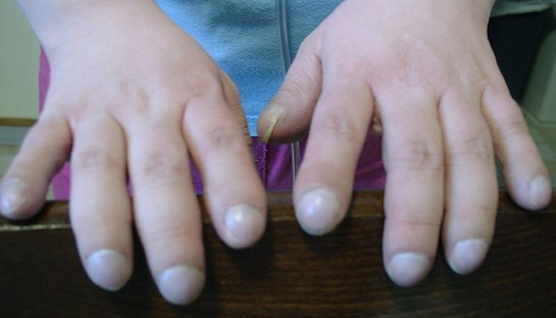
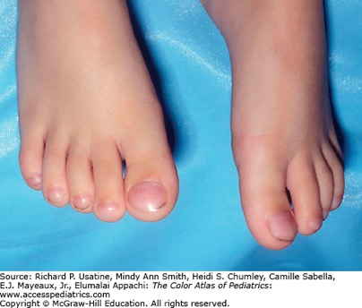
Respiratory examination - Clubbing
Associated with:
Chronic suppurative lung disease
Cystic fibrosis
Cyanotic congenital heart disease
Inflammatory bowel disease
Cirrhosis

Slide 22
Respiratory examination - Tachypnoea
Respiratory rate is dependent on age
Age | Normal (breaths/min) | Tachypnoea (breaths/ min)
Neonate (<4 weeks) | 30 – 50 | >60
Infants (<1 year) | 25 - 40 | >50
Young children (2-5 years) | 25 - 35 | >40
Older children | 20 - 25 | ⩾30

Slide 23
Respiratory examination - Dyspnoea
Use of accessory muscles (sternocleidomastoid)
Nasal flaring
Expiratory grunting
Recession of chest wall
Difficulty speaking

Slide 24
Respiratory examination - Chest shape
Hyperexpansion/ barrel shape
Pectus excavatum (hollow chest)
Pectus carinatum (pigeon chest)
Harrison’s sulcus
Asymmetry of chest wall movements

Slide 25
Respiratory examination - Palpation
Chest expansion (normal 3-5cm)
Tracheal deviation
Uncomfortable. Done selectively (eg. Detect mediastinal shift when suspecting tension pneumothorax)
Location of apex (to detect mediastinal shift)

Slide 26
Respiratory examination - Percussion
To be done gently
Dullness may indicate:
Collapse
Consolidation
Fluid

Slide 27
Respiratory examination - Auscultation (ears and stethoscope)
Note quality of breathing and symmetry of breath sounds and any added sounds
Cough – note its character
Hoarse voice – abnormality of the vocal cords
Stridor – harsh, low-pitched, mainly inspiratory sound from upper airways obstruction
Harsh breath sounds from the upper airways are readily transmitted to the upper chest in infants
Breath sounds
Normal are vesicular
Bronchial breathing is higher pitched and length of inspiration and expiration are equal
Wheeze – high-pitched, expiratory sound from distal airway obstruction
Crackles – discontinuous ‘moist’ sounds from the opening of bronchioles
Abnormal respiratory sounds may be inaudible in a child who is taking shallow, rapid breaths but may be detectable when the child takes big breaths

Slide 28
Cardiovascular examination - Overview
Cyanosis
Clubbing
Pulse
Inspection
Palpation
Percussion
Auscultation
Heart sounds
Murmurs
Hepatomegaly
Femoral pulses
Blood pressure

Slide 29
Cardiovascular examination - Cyanosis

Slide 30
Cardiovascular examination - clubbing

Slide 31
Cardiovascular examination - Pulse
Rate
Rhythm
Sinus arrhythmia is normal
Volume
Small (circulatory insufficiency or aortic stenosis)
Increased (stress, anaemia)
Collapsing (patent ductus arteriosus, aortic regurgitation)
Age | Normal range (beats/min)
<1 year | 110 - 160
2-5 years | 95 - 150
5-12 years | 80 - 120
>12 years | 60 - 100

Slide 32
Cardiovascular examination - Inspection
Respiratory distress
Precordial bulge
Cardiac enlargement
Ventricular impulse
Thin
Hyperdynamic circulation
Left ventricular hypertrophy
Operative scars
Median sternotomy
Left lateral thoracotomy

Slide 33
Cardiovascular examination - Palpation
Apex beat
Thrill
Heave

Slide 34
Cardiovascular examination - Percussion
Cardiac border percussion is rarely helpful
Might want to percuss upper border of liver

Slide 35
Cardiovascular examination - Auscultation
Heart sounds
Splitting of second heart sound is normal on inspiration
Fixed splitting of second heart sound in atrial septal defects
Third heart sound in mitral area is normal in young children
Murmurs
Timing – systolic/ diastolic/ continuous
Duration – mid-systolic (ejection)/ pansystolic
Loudness – systolic murmurs graded
1-2: soft, difficult to hear
3: easily audible, no thrill
4-6: loud with thrill
Site of maximal intensity – mitral/ pulmonary/ aortic/ tricuspid area
Radiation:
To neck: aortic stenosis
To back: coarctation of aorta or pulmonary stenosis

Slide 36
Cardiovascular examination - Hepatomegaly
Hepatomegaly is an important sign of heart failure in infants
Liver is normally palpable 1-2cm below the costal margin in infants

Slide 37
Cardiovascular examination – femoral pulses
Check for coarctation of aorta
In neonates
Femoral pulses are difficult to palpate
Upper limb pulses are easy to feel
In older children
Brachiofemoral delay

